Slide 1
Pseudocode
What is pseudocode? | Pseudocode is words or commands that have correlating meanings in coding languages.
What is pseudocode used for? | Pseudocode is used to create a plan and outline of how your program will work in regular words, which can then be translated into cade.
C# Instruction | Identify the pseudocode version (Must Use Indentation) | Identify the tool or construction AND describe it’s purpose | Explain when this might be used elsewhere (examples)
Console.WriteLine("Hello World!!"); | print (“Hello World!!”) | Output – displays hello world
Console.WriteLine(message); | Print (message) | Output – displays the contents of the variable named message
string name = " "; name = Console.ReadLine() | String name = “” Input name | Declares the variable a called name as a string type variable, initialises it. Input is set as variable name
int num1 = 5; int num2 = 6; int answer = 0; answer = num1 + num2; | Int num1 = 5 int num2 = 6 int answer = 0 answer = (num1 + num2) | Declares the 3 variables num1, num2 and answer as integers. Initialises num1 as ‘5’, num2 as ‘6’ and answer as ‘0’.
if (gameOver == true} { Console.WriteLine(“You lost”); } | If GameOver == true Print (“You lost “) ENDIF
for (int i = 0; i<=5; i++) { answer = answer + I; } | For int i = 0 i<=5 i = i+1 answer = answer + I
while (gameOver == false) { playerTurn(); gameOver = checkWin(); } | While gameOver == false playerTurn = true playGame gameOver = checkWin
do { playerTurn(); gameOver = checkWin(); }while (gameOver == false); | Do { playerTurn = true gameOver = checkWin } while gameOver == false

Slide 2
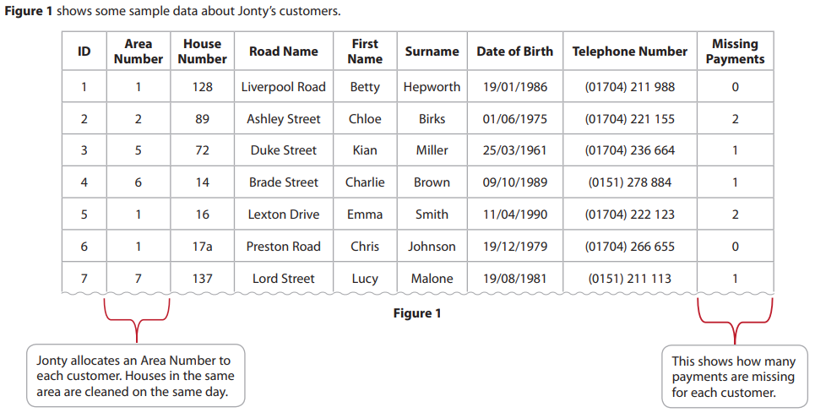
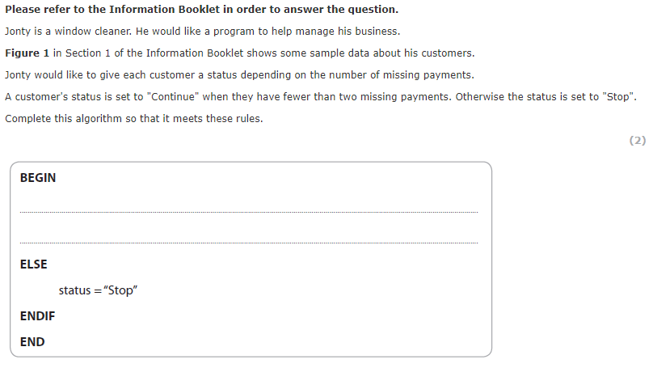
Bronze 1
Exam Questions
If missingPayment < 2
status = “Continue”

Slide 3
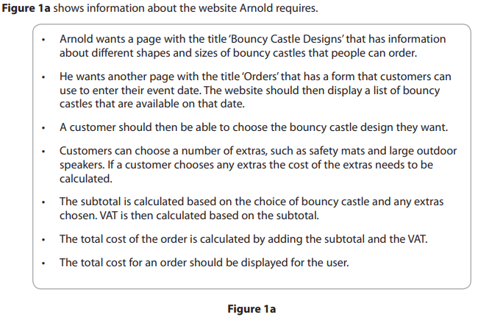
Bronze 2
Exam Questions

Slide 4
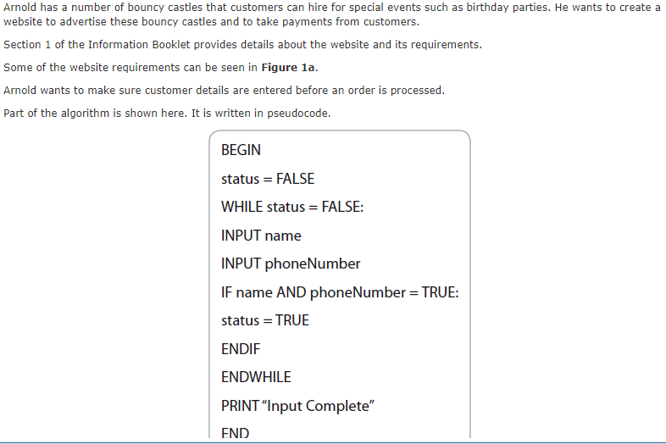
Bronze 2
Exam Questions
[3]
Indentations should be used to make the code more clear and specify which conditions are separate. Add comments to the statements. Separate the code into blocks to make it easier to read.

Slide 5
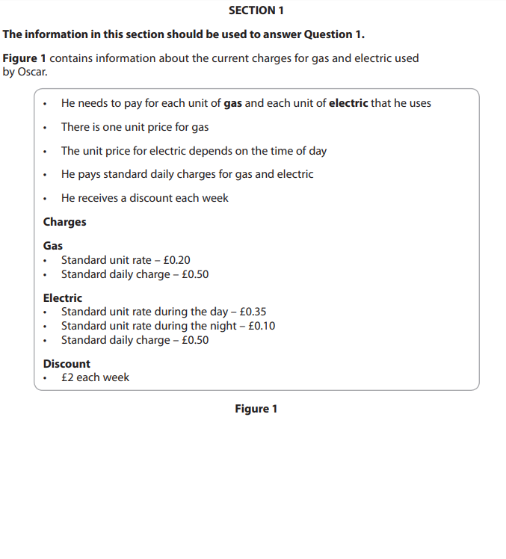
Bronze 3
Exam Questions

Slide 6
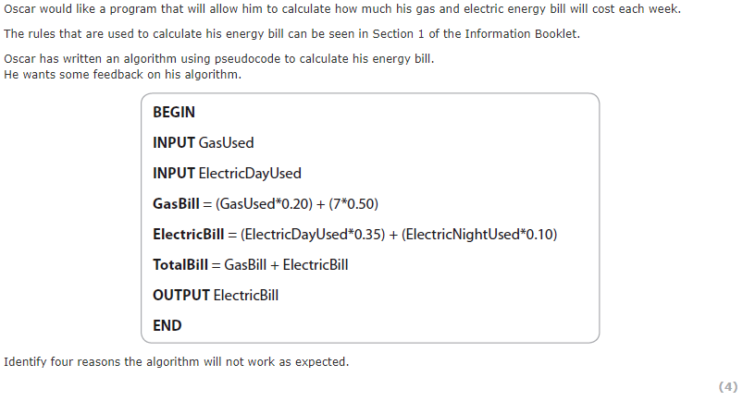
Bronze 3
Exam Questions
[4]
Electricity bill does not output the total The discount is not factored in The standard daily charge for electricity is not entered No input for electricNightUsed

Slide 7
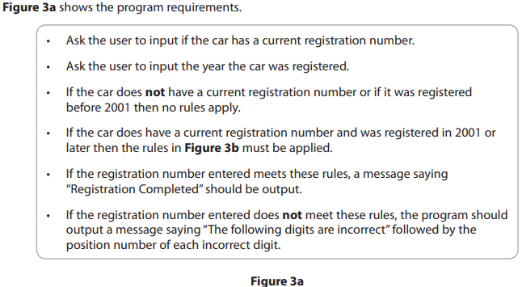
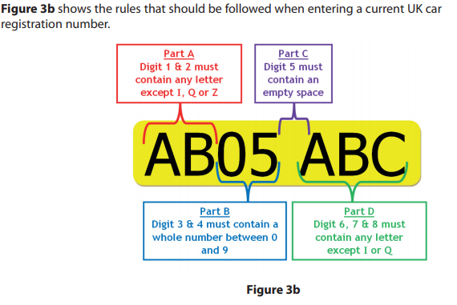
Silver 1
Exam Questions

Slide 8
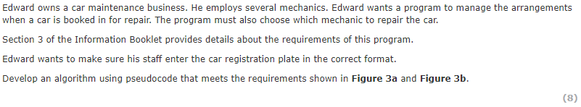
Silver 1
Exam Questions
Remember Readability is Important (Indentation, naming , END, Comments) [8]
Print ‘does the car have a current registration plate number’ Input isRegNumber Print ‘What year was the car registered’ Input regYear If isRegNumber = false or regYear < 2001 else Print ‘enter the reg number’ input regNumber if regNumber

Slide 9
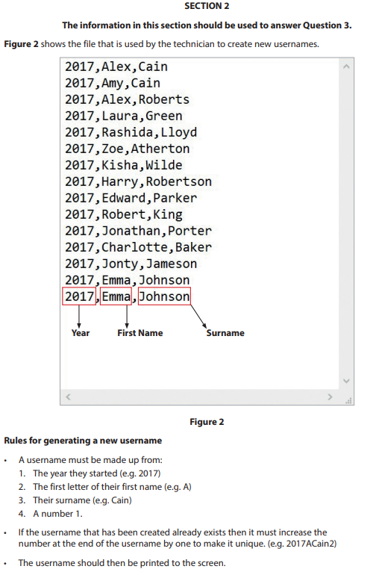
Silver 2
Exam Questions

Slide 10
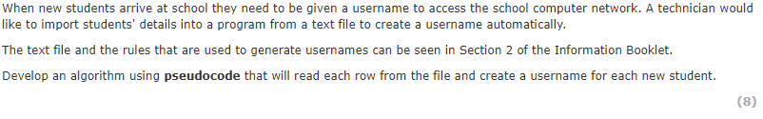
Silver 2
Exam Questions
Remember Readability is Important (Indentation, naming , END, Comments) [8]

Slide 11
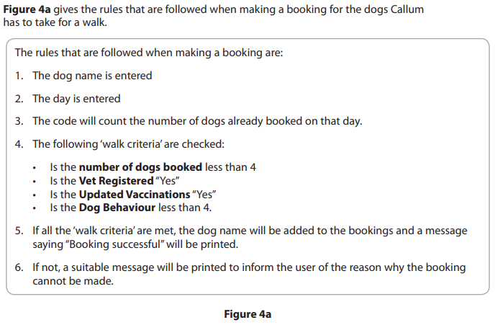
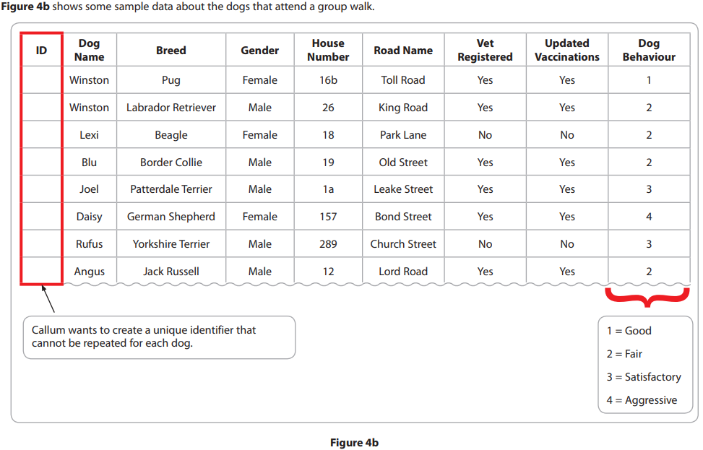
Gold 1
Exam Questions

Slide 12
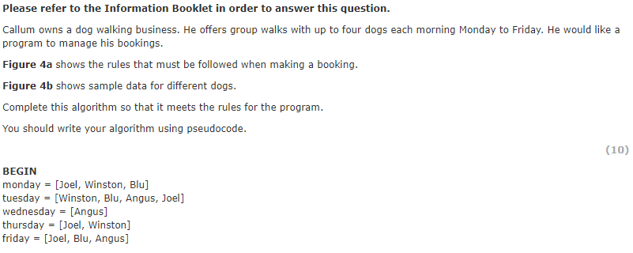
Gold 1
Exam Questions
Remember Readability is Important (Indentation, naming , END, Comments) [10]

Slide 13
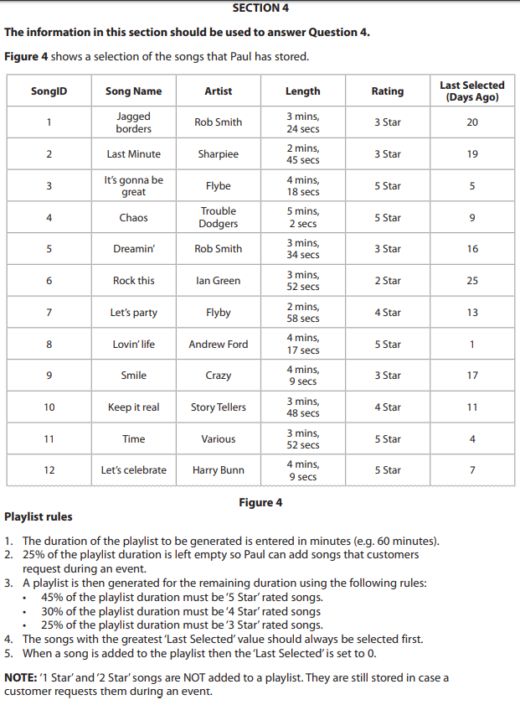
Gold 2
Exam Questions

Slide 14
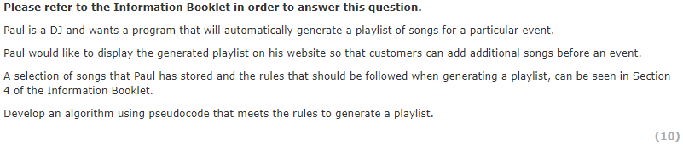
Gold 2
Exam Questions
Remember Readability is Important (Indentation, naming , END, Comments) [10]

Slide 15
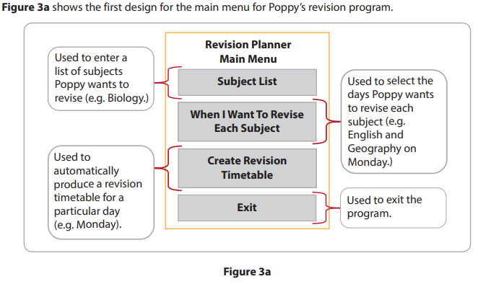
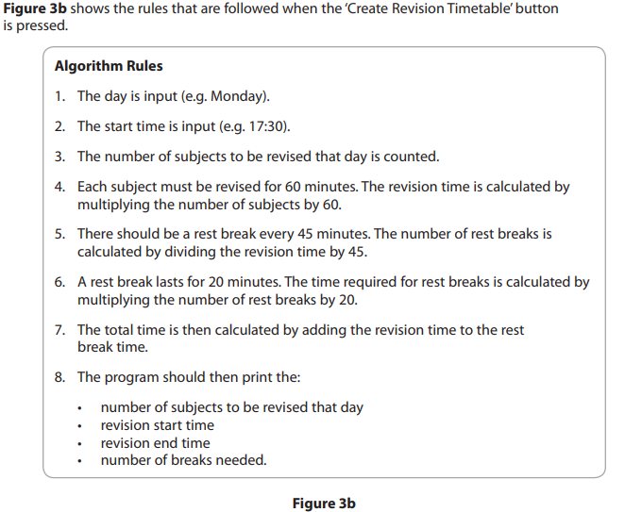
Platinum 1
Exam Questions

Slide 16
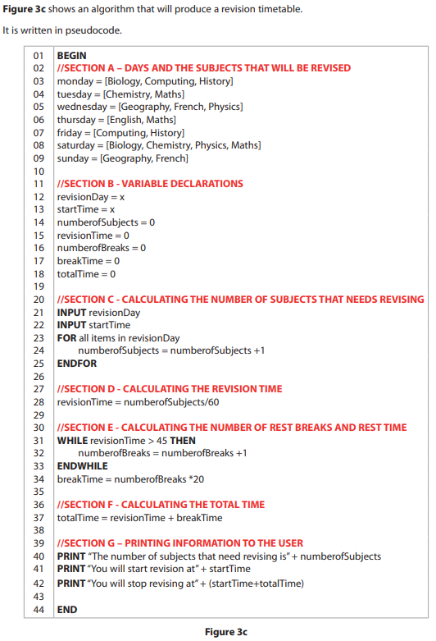
Platinum 1
Exam Questions

Slide 17
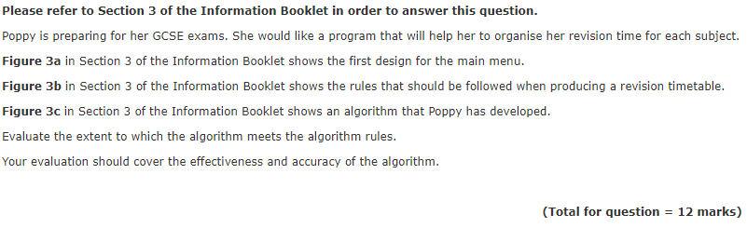
Platinum 1
Exam Questions
[12]

